Slide 1
Automated Public Lighting
TEAM:-FEU
TEAM LEAD:-REDDY MAMATHA
Notes:
TEAM:-FEU

Slide 2
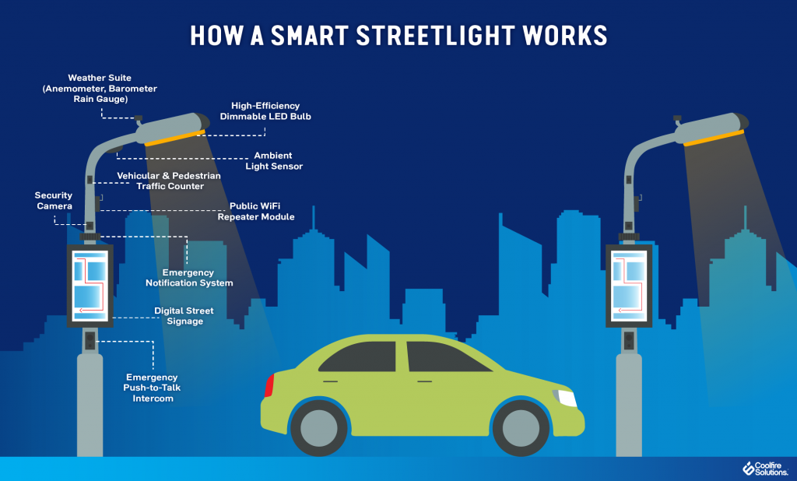
Introduction to Automated Public Lighting
Automated public lighting refers to the use of technology to control and manage streetlights in a more efficient and effective manner.
By utilizing sensors, timers, and communication systems, automated public lighting systems can adjust lighting levels based on real-time conditions.
These systems offer numerous benefits, including energy savings, improved safety, and reduced maintenance costs.
1
Notes:
Image source: http://ledjournal.com/smarter-led-street-lighting-applications/

Slide 3

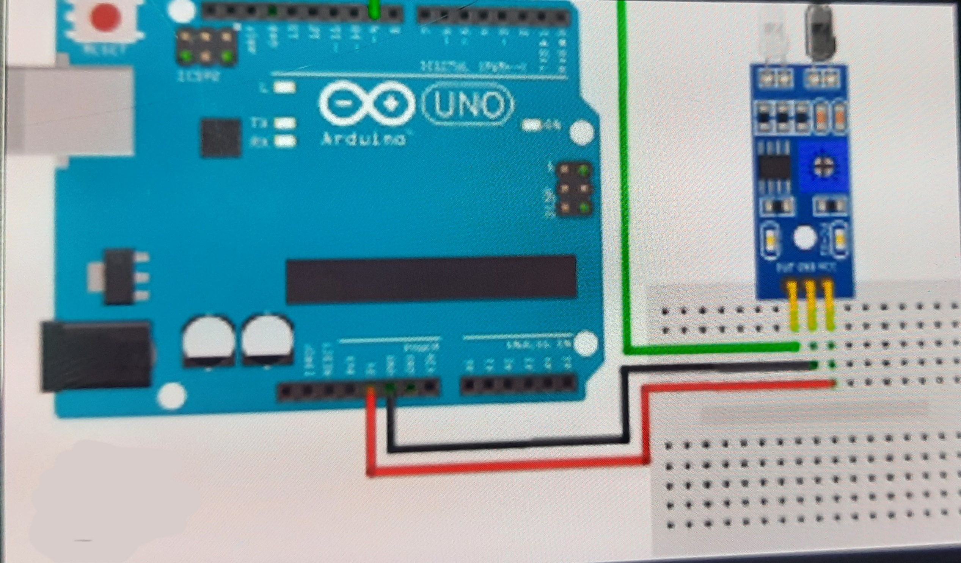
Usage of solar panels and iot technology
Automated public lighting systems can significantly reduce energy consumption by adjusting lighting levels based on the presence of pedestrians or vehicles.
Using motion sensors, lights can be dimmed or turned off when no activity is detected, resulting in substantial energy savings.
This technology also allows for the integration of renewable energy sources, such as solar panels, to further enhance sustainability.
2
Notes:
Image source: https://www.zgsmlightings.com/info/smart-street-lights-46086111.html

Slide 4
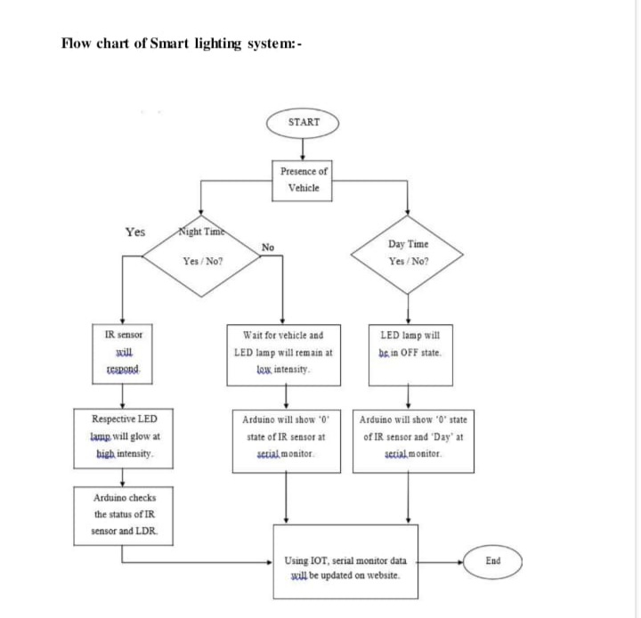

Slide 5
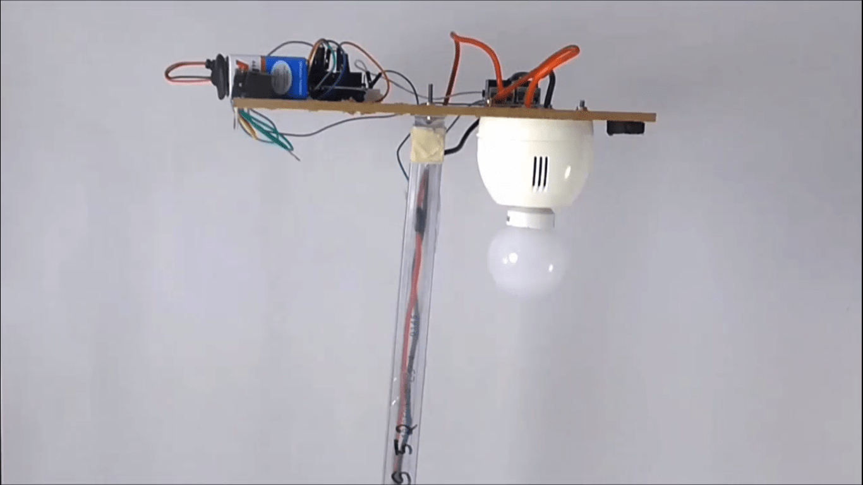
Improved Safety
Automated public lighting systems can enhance safety by ensuring optimal lighting levels at all times.
By dynamically adjusting lighting based on real-time conditions, these systems can eliminate dark spots and increase visibility in high-traffic areas.
Smart lighting can also detect and respond to emergency situations, providing additional illumination and helping emergency responders locate incidents quickly.
3
Notes:
Image source: https://www.desiretoexcel.com/project-ideas/latest-projects-based-on-safety

Slide 6
How a smart street light works
Automated public lighting systems can reduce maintenance costs by proactively monitoring .
The power is supplied from solar panel connected to the mother board. With the help of LDR,IR sensors,Arduino Uno as a micro controller the LED lights intensity is managed. A code or prompt is given to the arduino uno in java library.
These systems can detect faulty lights, damaged fixtures, or other issues, enabling timely repairs and minimizing downtime.
By remotely controlling and monitoring the lighting infrastructure, maintenance teams can be more efficient and responsive, reducing overall maintenance expenses.
4
Notes:
Image source: https://www.zgsmlightings.com/info/smart-street-lights-46086111.html

Slide 7
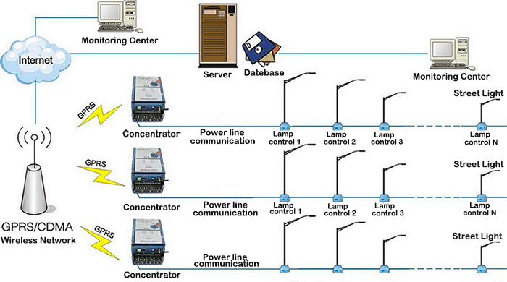
Smart Controls
Automated public lighting systems utilize advanced control mechanisms, such as centralized management software, to monitor and control individual streetlights or groups of lights.
These systems allow for real-time adjustments of lighting levels, scheduling of on/off times, and remote monitoring of performance.
Smart controls also enable the collection of valuable data, such as energy consumption and maintenance needs, for further optimization and analysis.
5
Notes:
Image source: https://www.sea.com.ua/en/news/automatic-street-light-control-system/

Slide 8
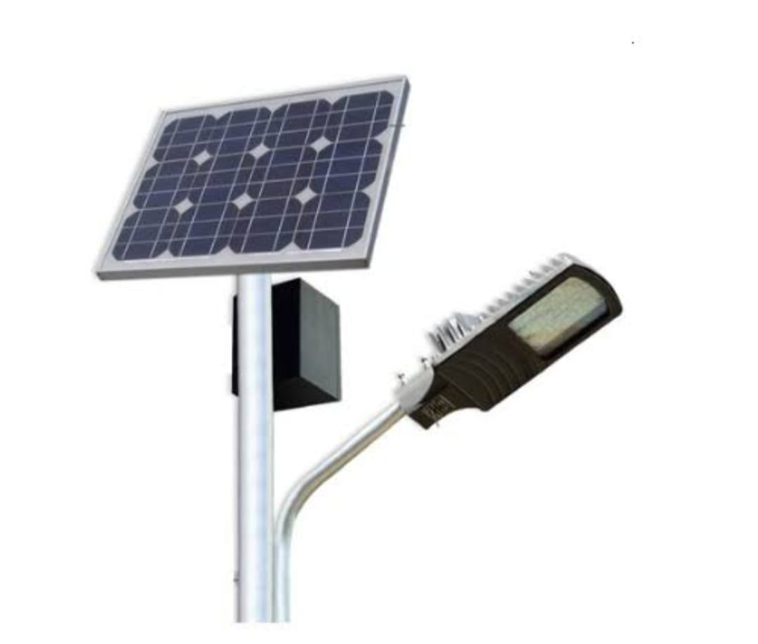
Cost Considerations
While the initial investment in automated public lighting systems may be higher compared to traditional lighting, the long-term cost savings outweigh the upfront costs.
Energy savings, reduced maintenance expenses, and improved operational efficiency contribute to a significant return on investment over time.
Additionally, many governments and utilities offer incentives and grants to encourage the adoption of energy-efficient lighting solutions.
7
Notes:
Image source: https://www.zgsmlightings.com/info/smart-street-lights-46086111.html

Slide 9

Conclusion
Automated public lighting is a transformative technology that offers energy efficiency, improved safety, and reduced maintenance costs for cities.
With the potential for integration into smart city initiatives, these systems play a crucial role in creating sustainable, efficient, and livable urban environments.
By harnessing the power of automation and advanced controls, cities can enhance their public lighting infrastructure and positively impact the lives of their residents.
10
Notes:
Image source: https://www.interventionprevention.com/en/reduced-energy_operating_modes/

